Slide 1


Elevator
Open door
Term-project
201232342 박재성
201332934 전아름
201533652 안연선
201533656 유지민

Slide 2
Open the door!
CONTENTS
01.
Purpose
02.
Demo Video
03.
Method
04.
Schedule
05.
Role

Slide 3
01
Purpose

Slide 4


Open the door!
purpose
Purpose
Time
Even
Odd
Underground
Reduce time

Slide 5
02
Demo video

Slide 6
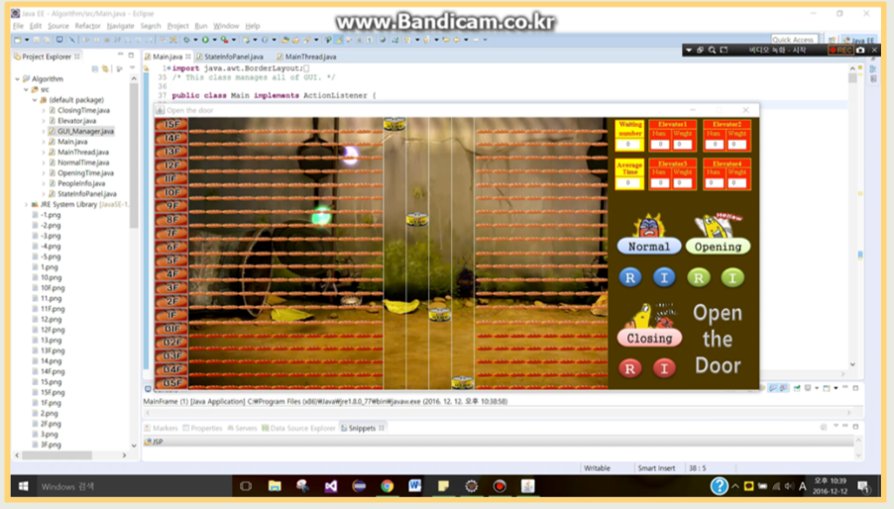
Open the door!
Demo video

Slide 7
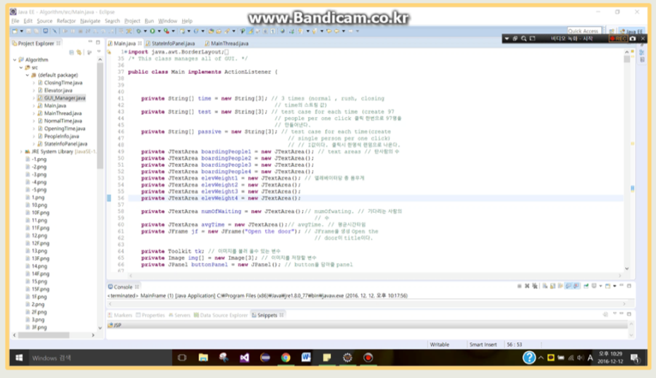
Open the door!
Demo video

Slide 8
03
Method

Slide 9

`
Method
Design
Code
<NormalTime>
<StateInfoPanel>
<OpeningTime>
<ClosingTime>
<MainThread>
<GUI_Manager>
<Elevator >
<PeopleInfo>
<Main>

Slide 10
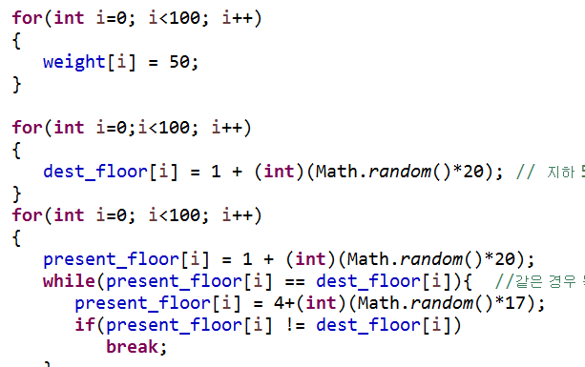
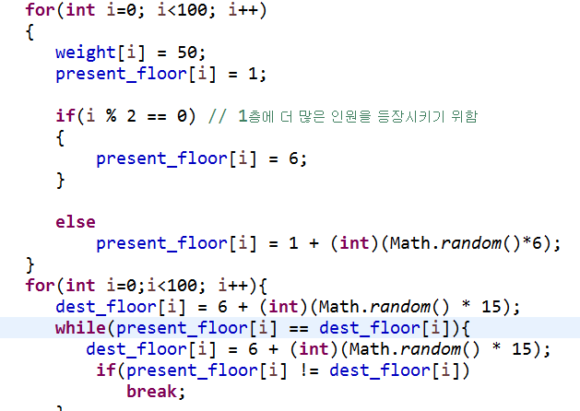
Open the door!
Code Method
<NormalTime>
< OpeningTime >
Test Random people in normal time. Each person has random present/dest floor
Test Random people in Openning time. Each person has present floor in range of (B5F~1F), and has random dest floor.

Slide 11
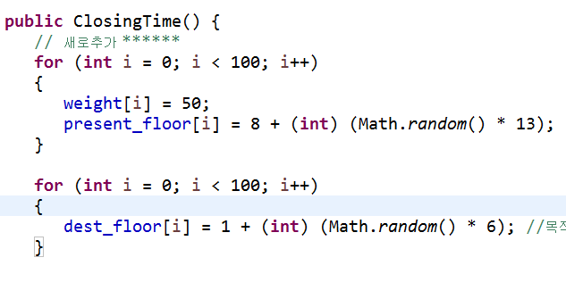
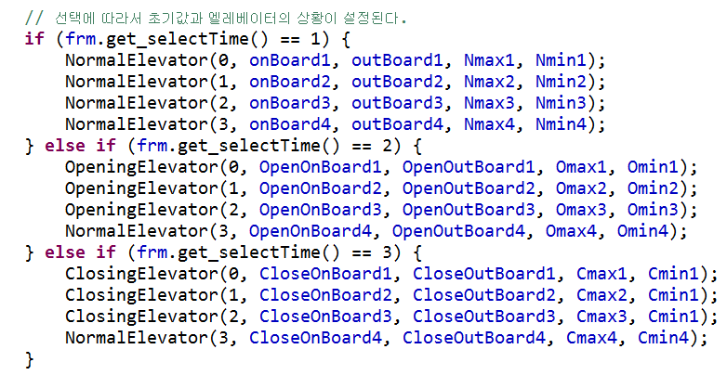
Open the door!
Code Method
< ClosingTime >
< MainThread>
Test Random people in closing time. Each person has random present floor, and has dest floor in range of (B5F~1F).
Mange elevators go up and down, and people board and get out in each time. Using ArrayList<>

Slide 12
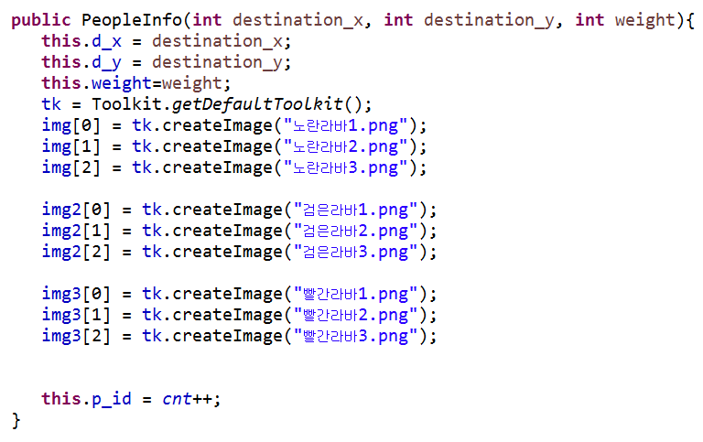
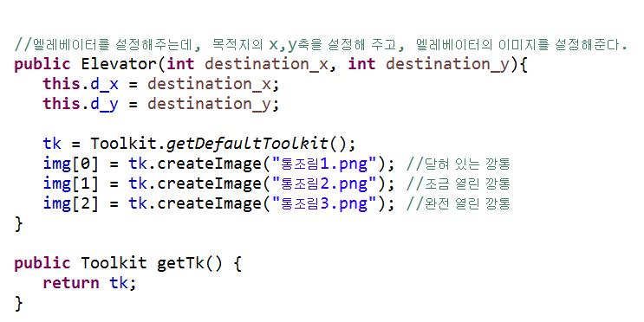
Open the door!
Code Method
< PeopleInfo>
< Elevator >
Each people’s information about present floor, destination floor, and weight. Scheduling start/end time. Check riding or waiting.
Apply elevator image, positioning it in frame (x,y-coordinate), check open, go up, down, weight over.

Slide 13
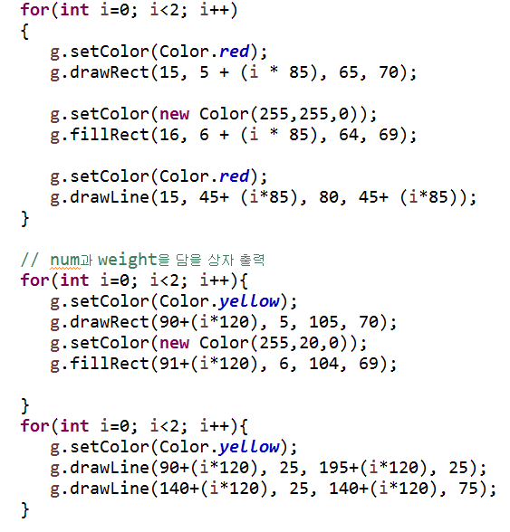
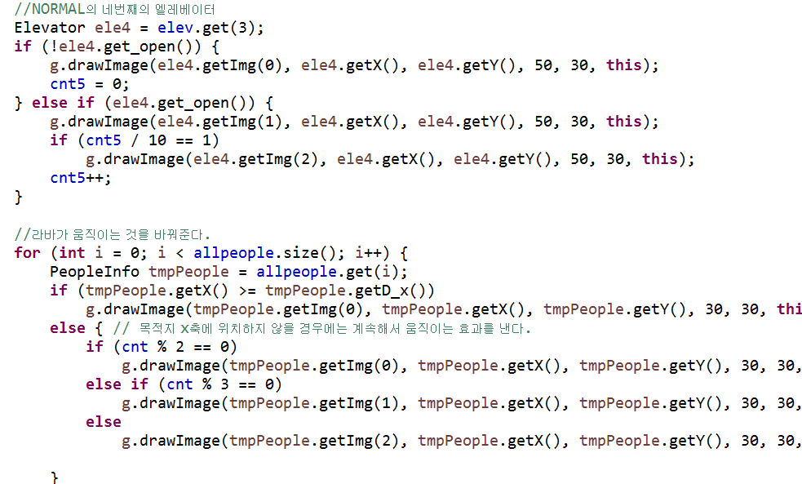
Open the door!
Design Method
< StateInfoPanel>
< GUI_Manager>
Panel of elevator’s information about waiting people, average time, the number of people, and weight.
Draw elevator at each event, background, all people in each time.

Slide 14
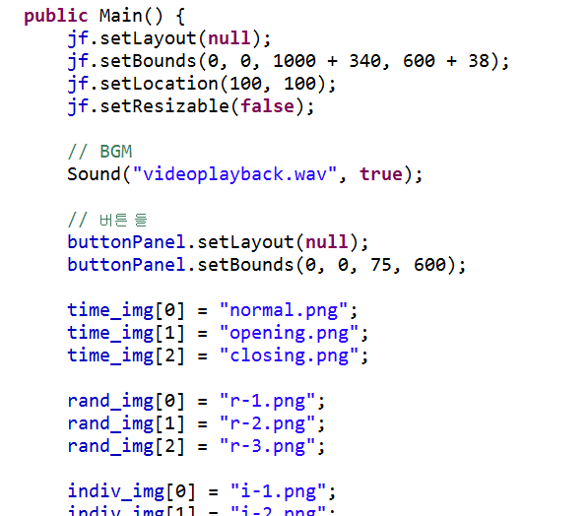
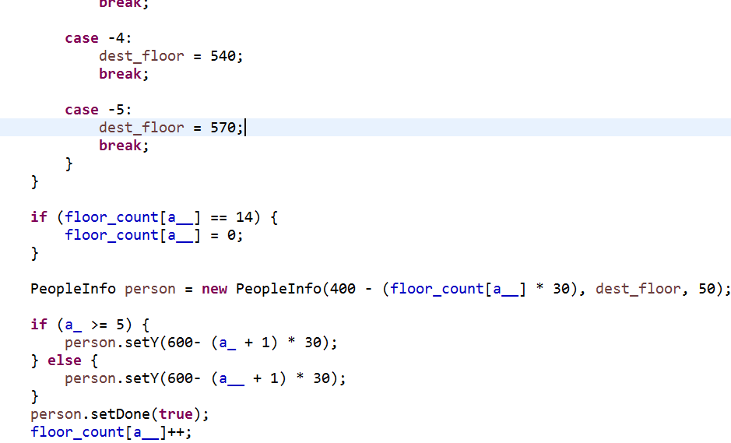
Open the door!
Design Method
< Main>
Take a role of Overall Management as a whole, frame, and implement of remote reservation system.

Slide 15
04
Schedule

Slide 16


Open the door!
11 Schedule
 |  | 1 | 2 | 3 | 4 | 5
6 | 7 | 8 | 9 | 10 | 11 | 12
13 | 14 | 15 | 16 | 17 | 18 | 19
20 | 21 | 22 | 23 | 24 | 25 | 26
27 | 28 | 29 | 30
Algorithm
Algorithm
Algorithm

Slide 17
Open the door!
12 Schedule
 |  |  |  | 1 | 2 | 3
4 | 5 | 6 | 7 | 8 | 9 | 10
11 | 12 | 13 | 14 | 15 | 16 | 17
18 | 19 | 20 | 21 | 22 | 23 | 24
25 | 26 | 27 | 28 | 29 | 30 | 31
GUI&Debugging
GUI&Debugging
final
100%

Slide 18
Open the door!
Design Method
38 + 183 + 267 + 895 + 1207 + 40 + 44 + 172 +108
= 2954줄

Slide 19
05
Role

Slide 20



Open the door!
Role
Overall Coding,Debugging
박재성
전아름
안연선
유지민
Closing time
GUI
Presenter
PPT
Normal time
Research
image
Remote reservation
Opening time
(Even, Odd floor)
Research Image
Normal time

Slide 21

Thank you

